Slide 1



BOOK A DOCTOR USING MERN
TEAM ID: NM2024TMID10278
TEAM MEMBERS:
PAVITHRA M (211521104103)
ASHWINI G A(211521104016)
BOOMIKA A(211521104023)
DEEPIKA S(211521104033)
POTHIGAI ELAMUHIL P(211521104106)

Slide 2

TABLE OF CONTENTS
ABSTRACT
INTRODUCTION
PROPOSED SYSTEM
IMPLEMENTATION:MERN STACK
FRONTEND
BACKEND
INTEGRATION
BLOCK DIAGRAM
MODEL SCREENSHOT
CONCLUSION

Slide 3

ABSTRACT
Book A Doctor is a MERN-based web application designed to simplify doctor appointment bookings. Patients can browse available doctors, view profiles, and schedule appointments, while doctors manage their availability and appointments efficiently. Admins oversee system users to maintain integrity. With secure JWT authentication and Bcrypt password encryption, Book A Doctor provides a streamlined, secure solution for managing healthcare appointments, showcasing the scalability and responsiveness of the MERN stack in a healthcare context.

Slide 4

INTRODUCTION
Book A Doctor is a MERN-based web app designed for seamless doctor appointment bookings. It enables patients to browse and book doctors, while doctors manage their schedules. With secure JWT authentication and Bcrypt encryption, this app offers a secure and efficient solution for healthcare appointments, showcasing the MERN stack’s scalability.

Slide 5

PROPOSED SYSTEM
The Book A Doctor system offers an efficient digital platform for organizing doctor appointments. Patients can select doctors based on availability and book appointments directly, while doctors have tools to update availability, manage bookings, and track schedules. An administrative interface allows admins to manage users and maintain system security. By reducing manual processes, this system enhances accessibility, optimizes appointment management, and ensures data security through JWT authentication and encrypted passwords, providing a streamlined healthcare booking experience.

Slide 6

IMPLEMENTATION:MERN STACK
FRONTEND
Technology: React
Utilizes React for building a dynamic and responsive user interface.
Libraries:
React Router: Enables smooth navigation between different components.
Redux Toolkit: Manages application state effectively, simplifying state management across components.
Ant Design: Provides pre-designed UI components for a polished and professional look.
Axios: Handles HTTP requests to the backend API for data fetching and submission.

Slide 7
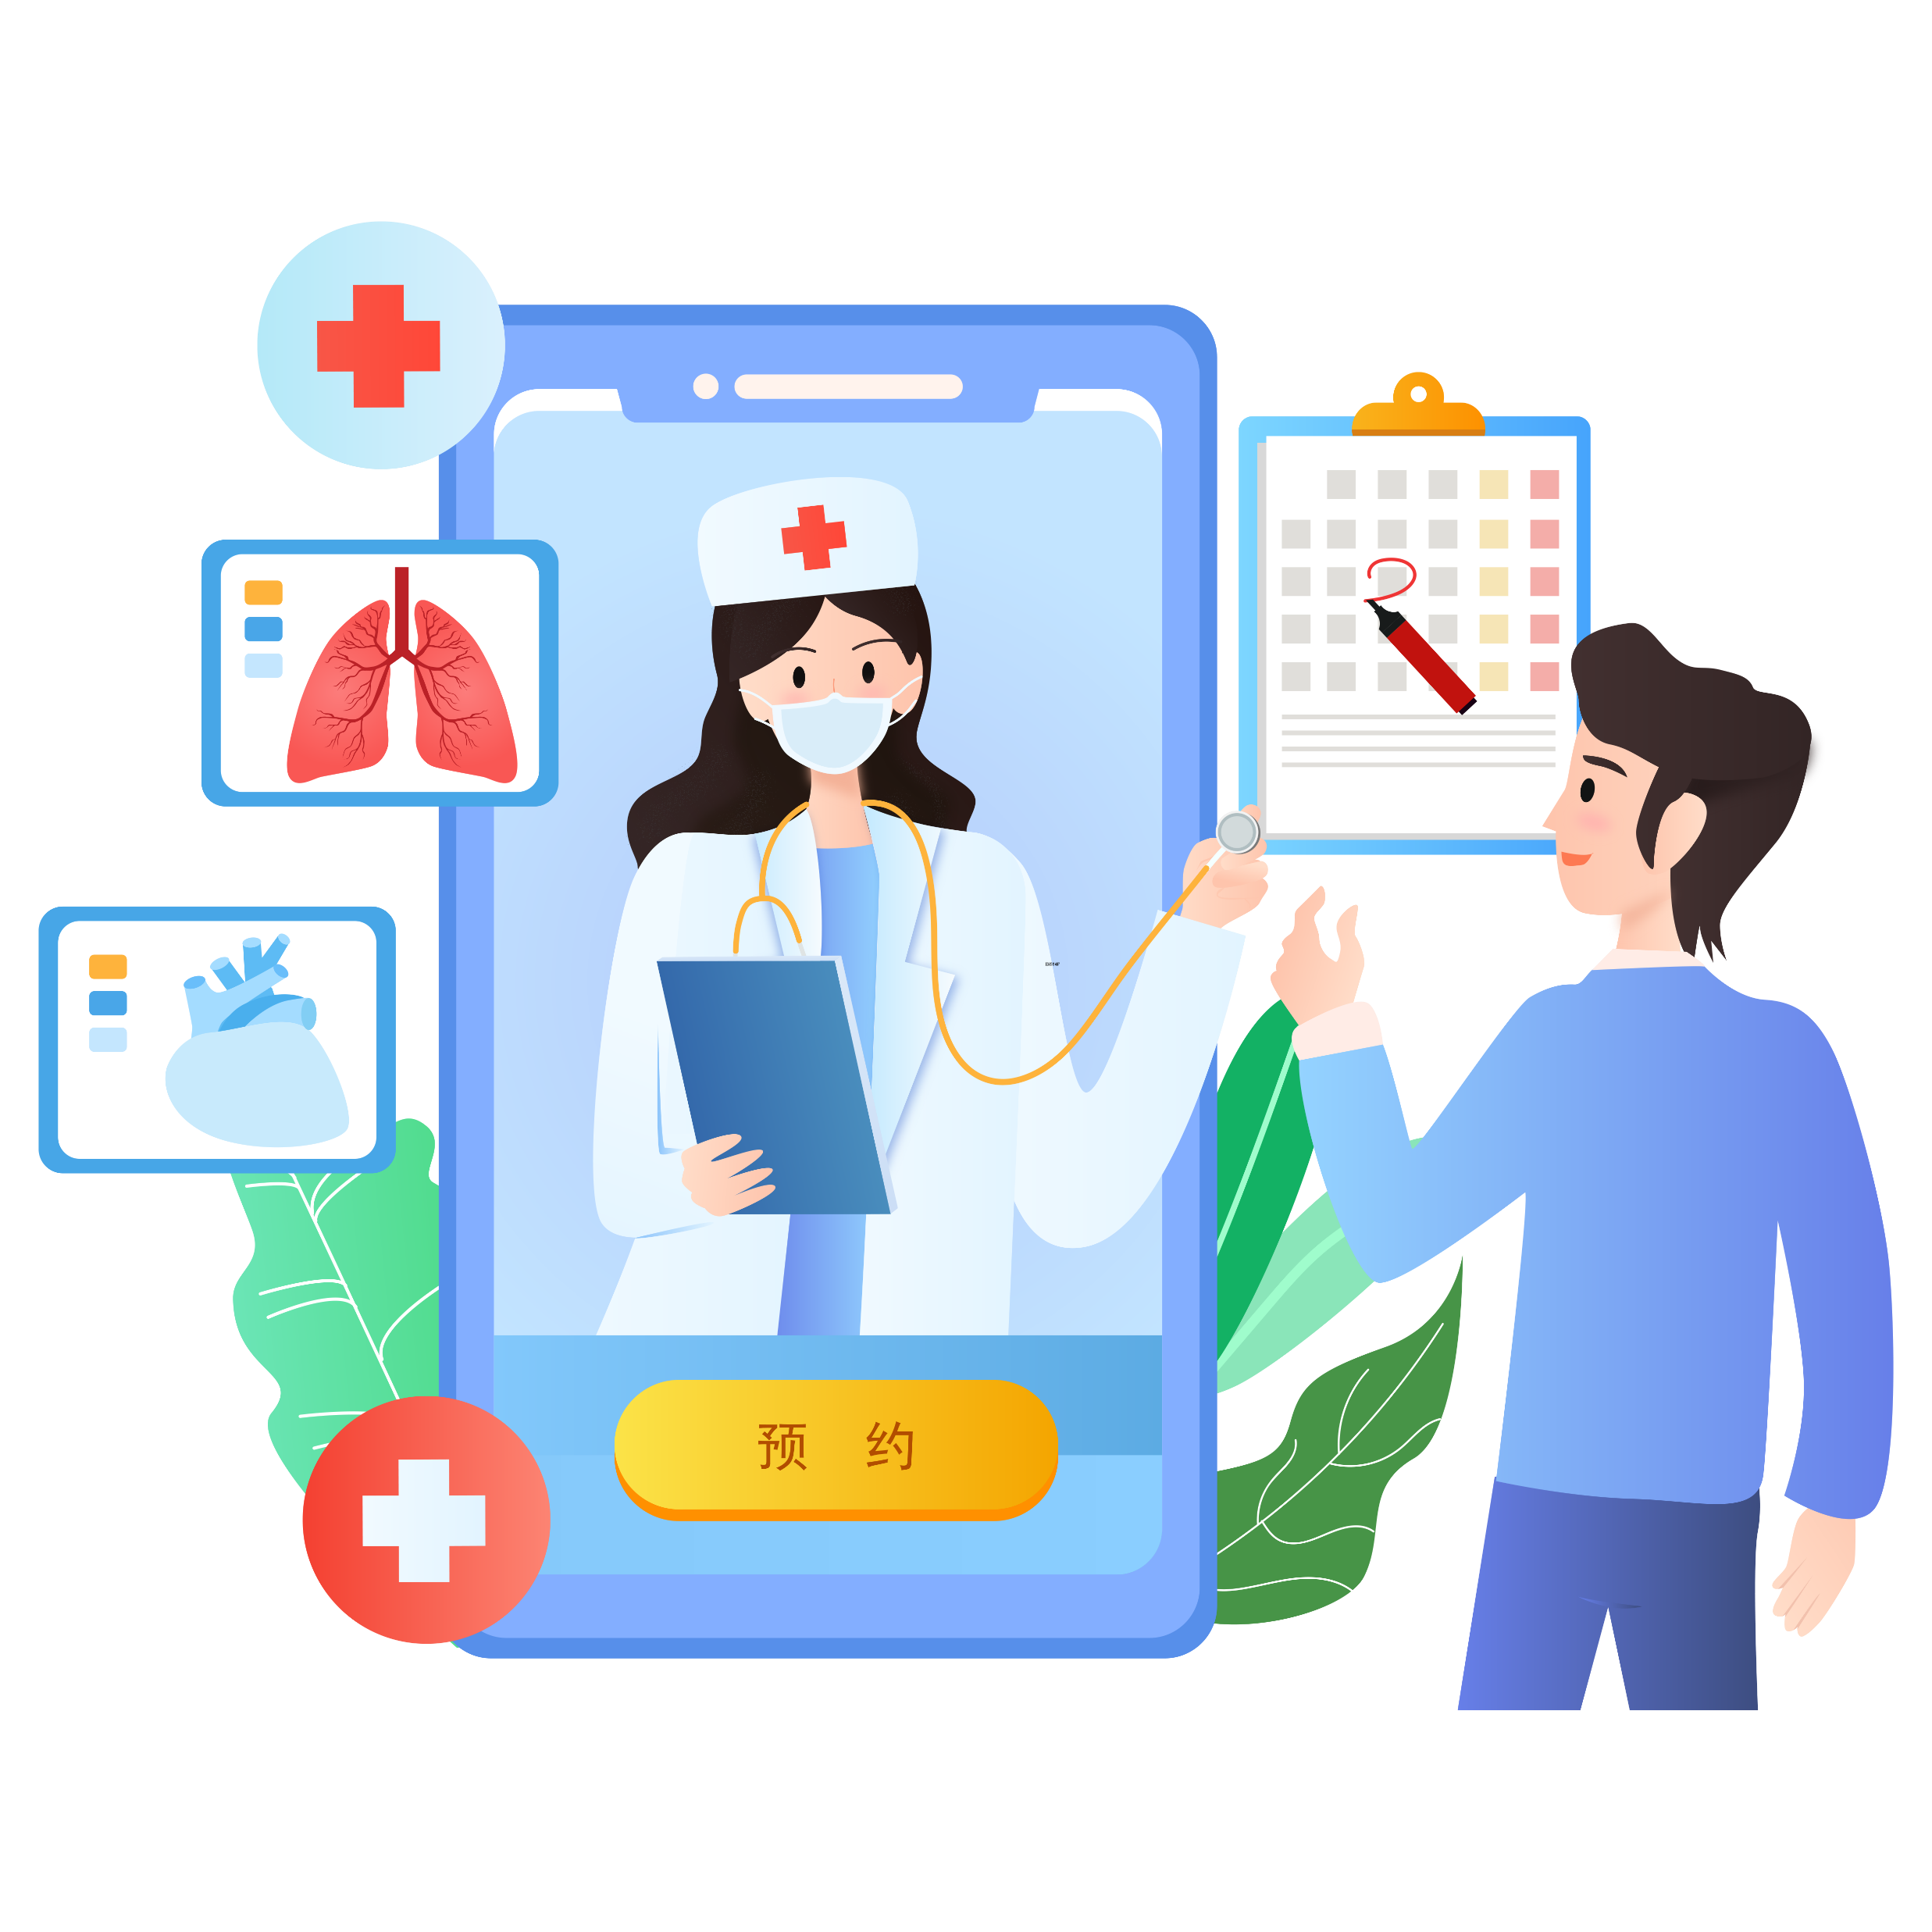
BACKEND
Technology: Node.js and Express
Utilizes Node.js for server-side scripting and Express for building web applications and APIs.
Libraries:
Express: Facilitates the creation of RESTful APIs for data management.
Mongoose: Provides a schema-based solution for modeling application data with MongoDB.
JWT: Implements secure user authentication using JSON Web Tokens.
Bcrypt: Handles password hashing for secure user authentication and data protection.

Slide 8
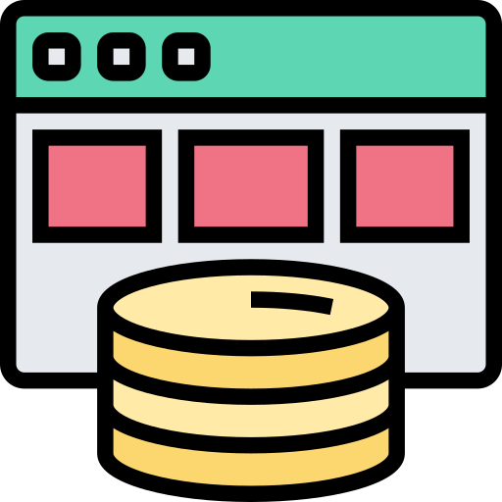
DATABASE
Technology: MongoDB
Utilizes MongoDB as a NoSQL database for storing application data.
Key Features:
Flexible Data Storage: Allows for dynamic schema designs, accommodating varied data types.
Collections:
Users Collection: Stores patient and doctor profiles, including personal details and credentials.
Appointments Collection: Manages scheduled appointments, including patient and doctor associations.

Slide 9

FULL-STACK INTEGRATION
Integration:
RESTful API: Enables communication between the frontend and backend through standardized API endpoints.
Axios: Facilitates easy and efficient data requests from the frontend to the backend.
JWT for Authentication: Secures user sessions, allowing only authorized access to protected resources.
Deployment:
Frontend: Hosted on Vercel for easy deployment and scalability.
Backend: Deployed on a cloud server (e.g., Heroku or AWS) for reliable performance and availability.

Slide 10
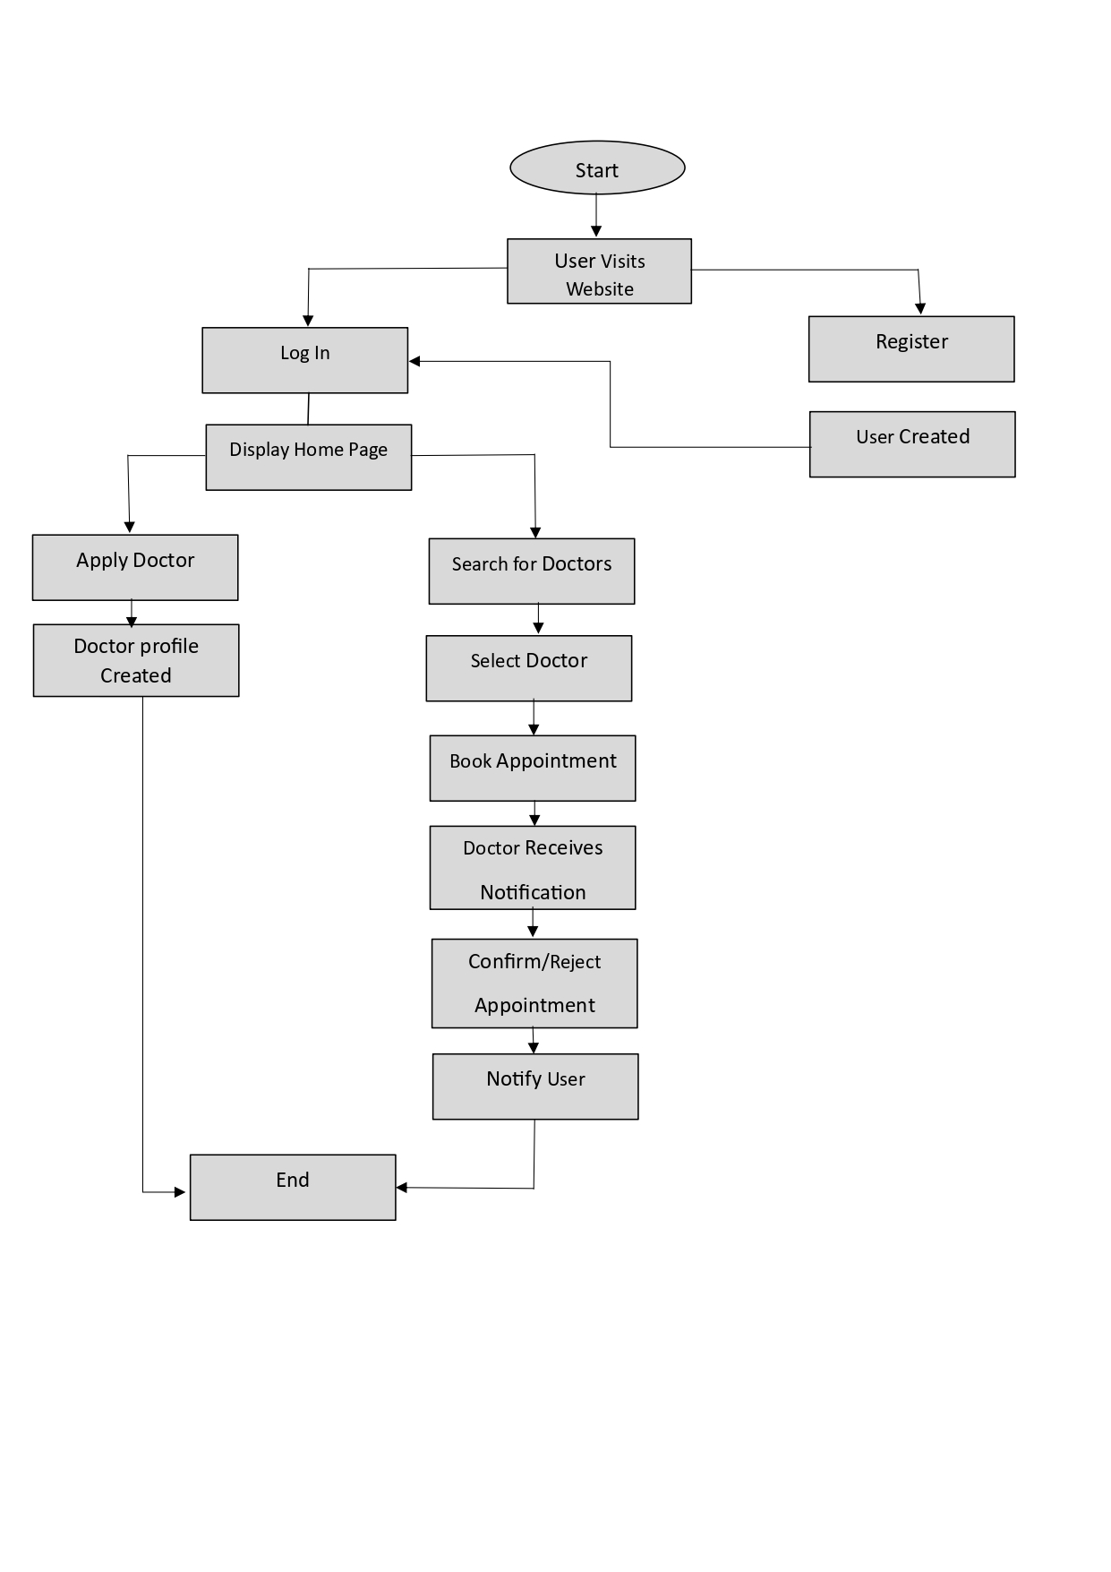
BLOCK DIAGRAM

Slide 11
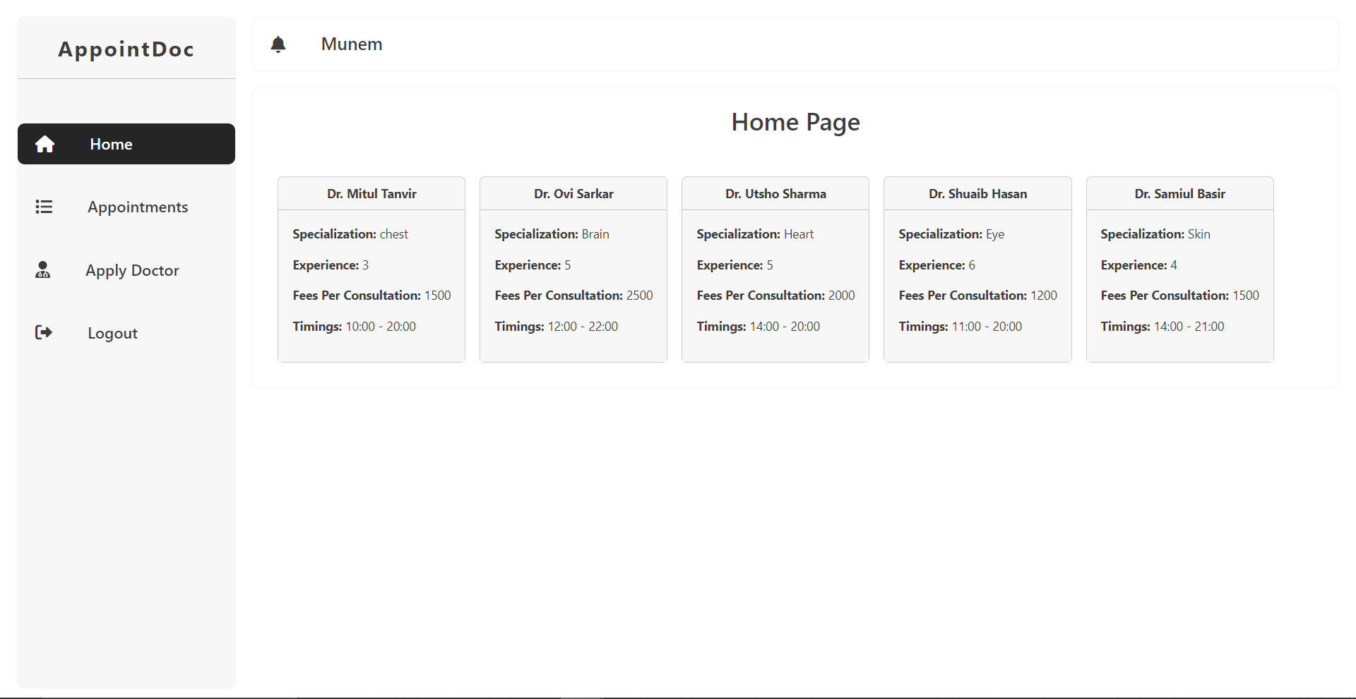
MODEL SCREENSHOT

Slide 12
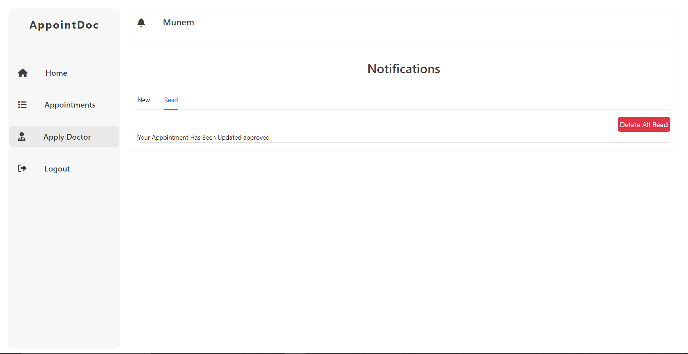

Slide 13

CONCLUSION AND NEXT STEPS
Book A Doctor effectively streamlines online doctor appointments, enhancing accessibility and communication for patients and doctors. Moving forward, we aim to add features like video consultations, reminders, and feedback options, improve user experience with a mobile app and multilingual support, scale up through cloud deployment, and strengthen security with data compliance and enhanced authentication.

Slide 14

THANK YOU

